Slide 1
String Searching Algorithm
指導教授:黃三益 教授
組員: 9142639 蔡嘉文
9142642 高振元
9142635 丁康迪

Slide 2
String Searching Algorithm
Outline:
The Naive Algorithm
The Knuth-Morris-Pratt Algorithm
The SHIFT-OR Algorithm
The Boyer-Moore Algorithm
The Boyer-Moore-Horspool Algorithm
The Karp-Rabin Algorithm
Conclusion

Slide 3
String Searching Algorithm
Preliminaries:
n: the length of the text
m: the length of the pattern(string)
c: the size of the alphabet
C_{n}: the expected number of comparisons
performed by an algorithm while searching
the pattern in a text of length n

Slide 4
The Naive Algorithm
Char text[], pat[] ;
int n, m ;
{
int i, j, k, lim ; lim=n-m+1 ;
for (i=1 ; i<=lim ; i++) /* search */
{
k=i ;
for (j=1 ; j<=m && text[k]==pat[j]; j++) k++;
if (j>m) Report_match_at_position(i-j+1);
}
}

Slide 5
The Naive Algorithm(cont.)
The idea consists of trying to match any
substring of length m in the text with the
pattern.

Slide 6
The Knuth-Morris-Pratt Algorithm
{
int j, k ;
int next[Max_Pattern_Size];
initnext(pat, m+1, next); /*preprocess pattern, 建立
j=k=1 ; next table*/
do{ /*search*/
if (j==0 || text[k]==pat[j] ) k++; j++;
else j=next[j] ;
if (j>m) Report_match_at_position(k-m);
} while (k<=n)
}

Slide 7
The Knuth-Morris-Pratt Algorithm(cont.)
To accomplish this, the pattern is preprocessed to obtain a table that gives the next position in the pattern to be processed after a mismatch.
Ex:
position: 1 2 3 4 5 6 7 8 9 10 11
pattern: a b r a c a d a b r a
Next[j]: 0 1 1 0 2 0 2 0 1 1 0
text: a b r a c a f ……………

Slide 8
The Shift-Or Algorithm
The main idea is to represent the state of the search as a number.
State=S₁．2⁰＋S₂．2¹+…+S_{m}．2^{m-1}
T_{x}=δ(pat₁=x) ． 2⁰＋ δ(pat₂=x) +…..+ δ(pat_{m}=x) ． 2^{m-1}
For every symbol x of the alphabet, whereδ(C) is 0 if the condition C is true, and 1 otherwise.

Slide 9
The Shift-Or Algorithm(cont.)
Ex:{a,b,c,d} be the alphabet, and ababc the pattern.
T[a]=11010,T[b]=10101,T[c]=01111,T[d]=11111
the initial state is 11111

Slide 10
The Shift-Or Algorithm(cont.)
Pattern: ababc
Text: a b d a b a b c
T[x]:11010 10101 11111 11010 10101 11010 10101 01111
State: 11110 11101 11111 11110 11101 11010 10101 01111
For example, the state 10101 means that in the current position we have two partial matches to the left, of lengths two and four, respectively.
The match at the end of the text is indicated by the value 0 in the leftmost bit of the state of the search.

Slide 11
The Boyer-Moore Algorithm
Search from right to left in the pattern
Shift method :
match heuristic
compute the dd table for the pattern
occurrence heuristic
compute the d table for the pattern

Slide 12
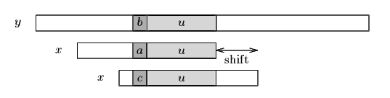
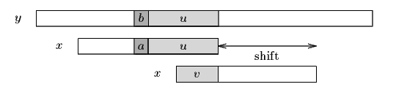
The Boyer-Moore Algorithm (cont.)
Match shift

Slide 13
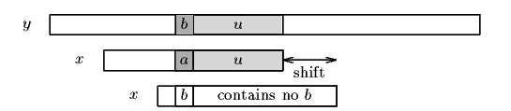
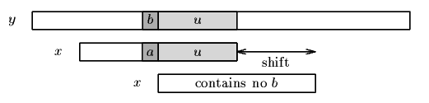
The Boyer-Moore Algorithm (cont.)
occurrence shift

Slide 14
The Boyer-Moore Algorithm (cont.)
k=m
while(k<=n){
j=m;
while(j>0&&text[k]==pat[j])
{ j -- , k -- }
if(j == 0)
{ report_match_at_position(k+1) ; }
else k+= max( d[text[k] , dd[j]);
}

Slide 15
The Boyer-Moore Algorithm (cont.)
Example
T : xyxabraxyzabracadabra
P : abracadabra
mismatch, compute a shift

Slide 16
The Boyer-Moore-Horspool Algorithm
A simplification of BM Algorithm
Compares the pattern from left to right

Slide 17
The Boyer-Moore-Horspool Algorithm(cont.)
for(k=;k<=m;k++) d[pat[k] = m+1-k;
pat[m+1]=CHARACTER_NOT_IN_THE_TEXT;
lim = n-m+1;
for( k=1; k<=lim ; k+= d[text[k+m]] )
{
i=k;
for(j=1 ; text[i]==pat[j] ; j++) i++;
if( j==m+1) report_match_at_position(k);
}

Slide 18
The Boyer-Moore-Horspool Algorithm(cont.)
Eaxmple :
T : x y z a b r a x y z a b r a c a d a b r a
P : a b r a c a d a b r a

Slide 19
The Karp-Rabin Algorithm
Use hashing
Computing the signature function of each possible m-character substring
Check if it is equal to the signature function of the pattern
Signature function h(k)=k mod q, q is a large prime

Slide 20
The Karp-Rabin Algorithm(cont.)
rksearch( text, n, pat, m ) /* Search pat[1..m] in text[1..n] */
char text[], pat[]; /* (0 m = n) */
int n, m;
{
int h1, h2, dM, i, j;
dM = 1;
for( i=1; i<m; i++ ) dM = (dM << D) % Q; /* Compute the signature */
h1 = h2 = O; /* of the pattern and of */
for( i=1; i<=m; i++ ) /* the beginning of the */
{ /* text */
h1 = ((h1 << D) + pat[i] ) % Q;
h2 = ((h2 << D) + text[i] ) % Q;
}

Slide 21
The Karp-Rabin Algorithm(cont.)
for( i = 1; i <= n-m+1; i++ ) /* Search */
{
if( h1 == h2 ) /* Potential match */
{
for(j=1; j<=m && text[i-1+j] == pat[j]; j++ ); /* check */
if( j > m ) /* true match */
Report_match_at_position( i );
}
h2 = (h2 + (Q << D) - text[i]*dM ) % Q; /* update the signature */
h2 = ((h2 << D) + text[i+m] ) % Q; /* of the text */
}
}

Slide 22
Conclusions
Test: Random pattern, random text and English text
Best: The Boyer-Moore-Horspool Algorithm
Drawback: preprocessing time and space(depend on alphabet/pattern size)
Small pattern: The Shift-Or Algorithm
Large alphabet: The Knuth-Morris-Pratt Algorithm
Others: The Boyer-Moore Algorithm
“don’t care”: The Shift-Or Algorithm

